Slide 1
Linear Regression
Presented By
Pranali Yenkar

Slide 2
Agenda
Machine Learning
Regression
Types of Regression
Linear Regression

Slide 3
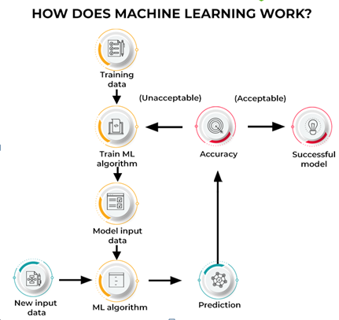
Machine Learning
Machine learning algorithms build a model based on sample data, known as training data, in order to make predictions or decisions without being explicitly programmed to do so

Slide 4
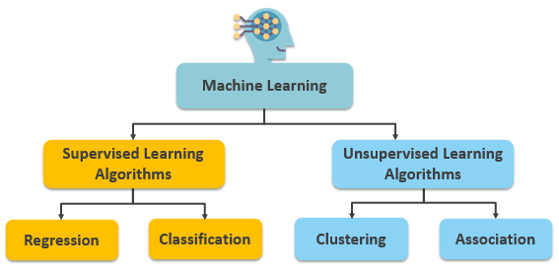
Machine Learning

Slide 5
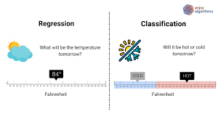
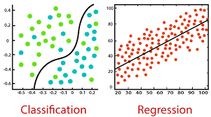
Supervised Machine Learning

Slide 6
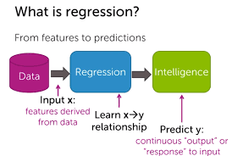
Regression Analysis
Form of predictive analytics
Predicting one variable on the basis of one or more variables
The variable we predict is –Dependent Variable
Base variables -Independent Variables
Height | Weight
5 | 80
4 | 65
3 | 50
6 | 90
2 | ??

Slide 7
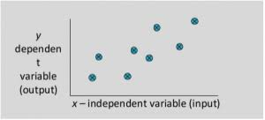
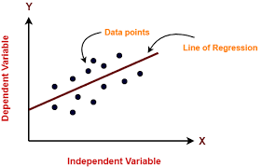
Linear Regression
Form of predictive analytics
Predicting one variable on the basis of one or more variables
The variable we predict is –Dependent Variable
Base variables -Independent Variables

Slide 8

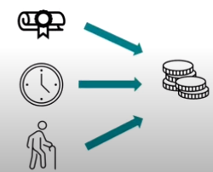
Type of Regression
Simple Linear Regression
Multiple Linear Regression

Slide 9
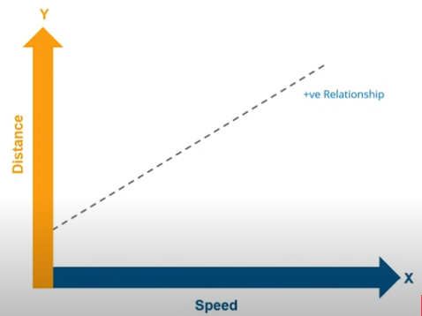
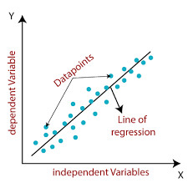
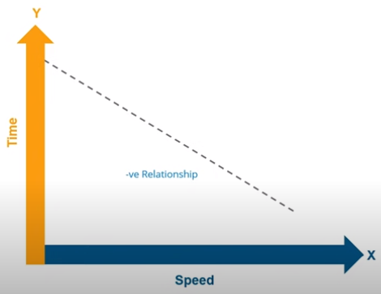
Linear Regression

Slide 10
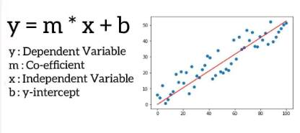
Linear Regression
m
B

Slide 11
Linear Regression
e.g. m=0.4 ,c=2,4
Y=0.4x+2.4
y
Height | Weight | Predicted
5 | 80 | 78
4 | 65 | 67
3 | 50 | 53
6 | 90 | 89
2 | ?? | 50
x

Slide 12
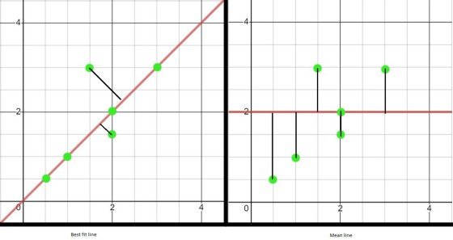
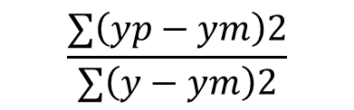
Linear Regression
$$\frac{∑\left(yp−ym\right)2}{∑\left(y−ym\right)2}$$
R Squared Error=
yp=predicted, ym=mean, y=actual

Slide 13
Use Cases
Real Estate
Marketing
Forecasting

